Slide 1
Using Machine Learning to Identify Non-thermal Filaments
By Sharif Khan-Bennett
1799796
Supervisor: Dr. Ian Stevens

Slide 2
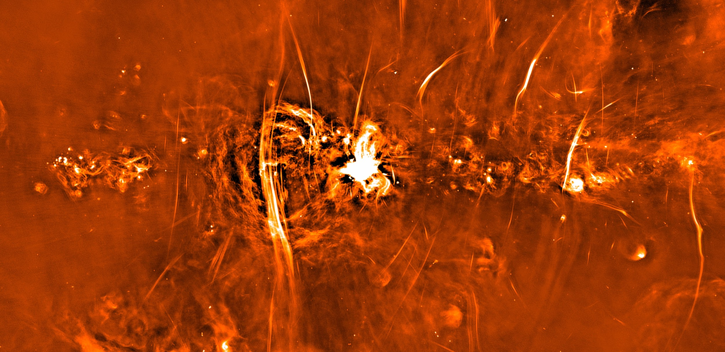
Overview
Next-Generation Radio Astronomy
Machine Learning
Convolutional Neural Nets (CNNs)
Classification
Optimisation
Overfitting
Layers
Generative Adversarial Networks (GANs)
Non-thermal Filaments
Preliminary Results
Remaining Investigation

Slide 3
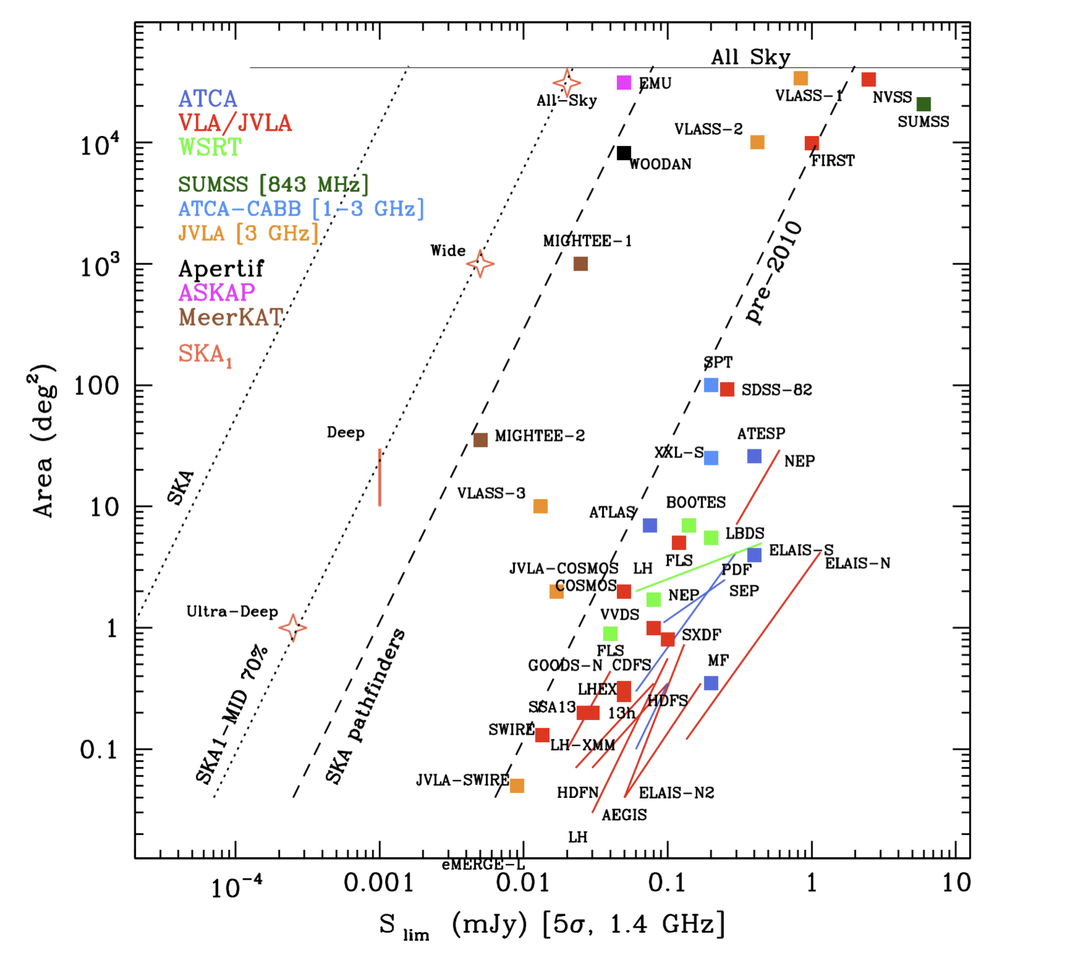
Next-Generation Radio Astronomy
The SKA will eventually be able to utilise a square kilometer of collecting area!
It will eventually consist of thousands of dishes and up to 1 million low-frequency antennas.
The entire array is expected to be operational by the late 2020s.
This means a LOT of data.
Prandoni I., Seymour N., 2015, Revealing the Physics and Evolution of Galaxies and Galaxy Clusters with SKA Continuum Surveys

Slide 4
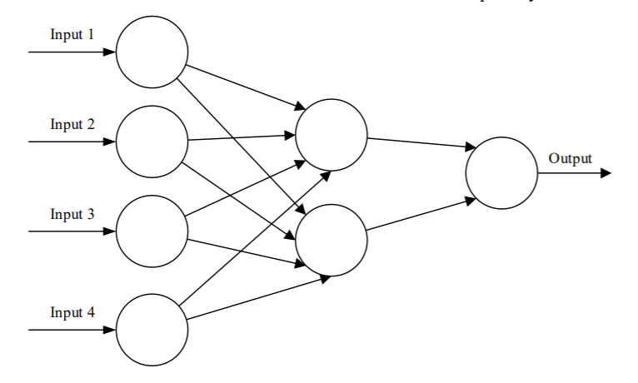
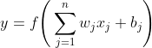
Machine Learning: Classification
Supervised Learning.
Inspired by the nervous system.
The neurons accept numeric data as inputs.
The output of a neuron is given by
The final layer gives a single number to predict the class of the object.
x₁
w₁
w₂
y
x₂
f
w₃
w₄
x₃
x₄
O'Shea, Keiron; Nash, Ryan, 2015, An Introduction to Convolutional Neural Networks

Slide 5
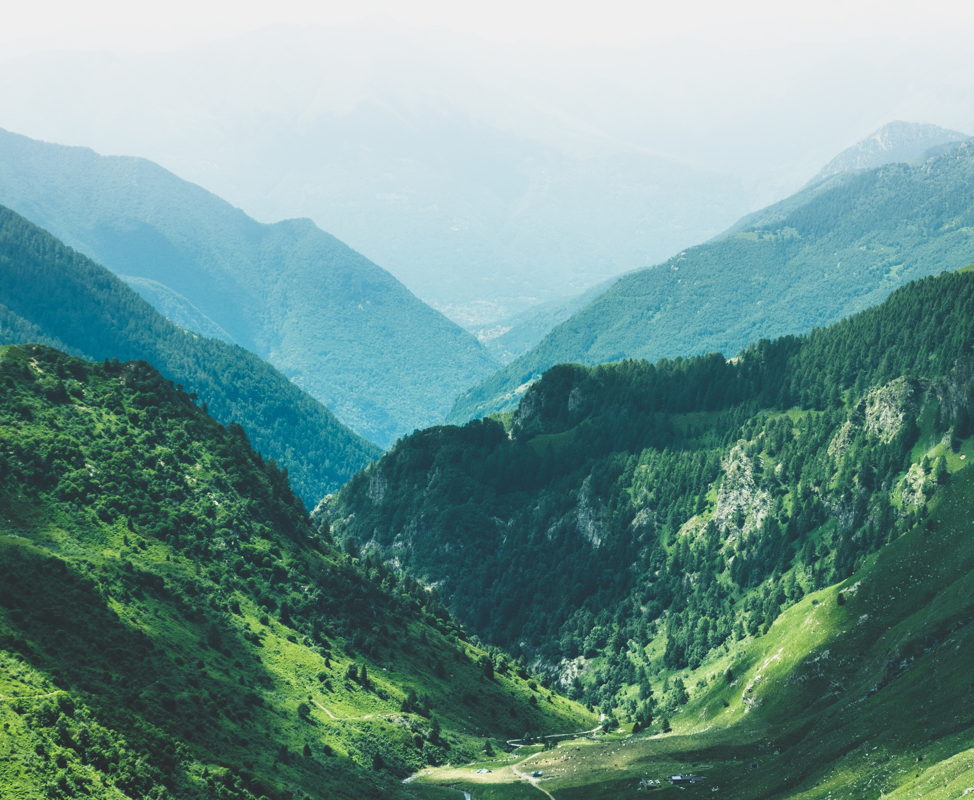
Machine Learning: Optimisation
After one forward propagation, a loss is found. This maps to an n-dimensional space.
Model convergence corresponds to the set of weights and biases producing minimum loss.
The learning rate determines the step size taken towards the minimum per back propagation.
https://www.ucg.org/members/united-news/god-of-the-hills-and-god-of-the-valleys

Slide 6
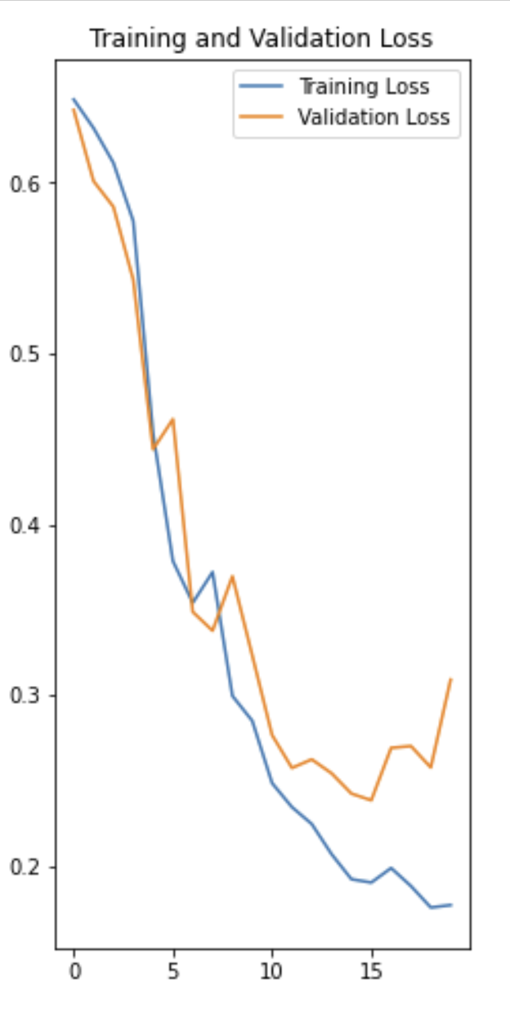
Machine Learning: Overfitting
This is a common problem with machine learning algorithms.
The model starts to memorise the testing data.
Can be mitigated with dropout layers, early stopping and avoiding overly complex models.

Slide 7
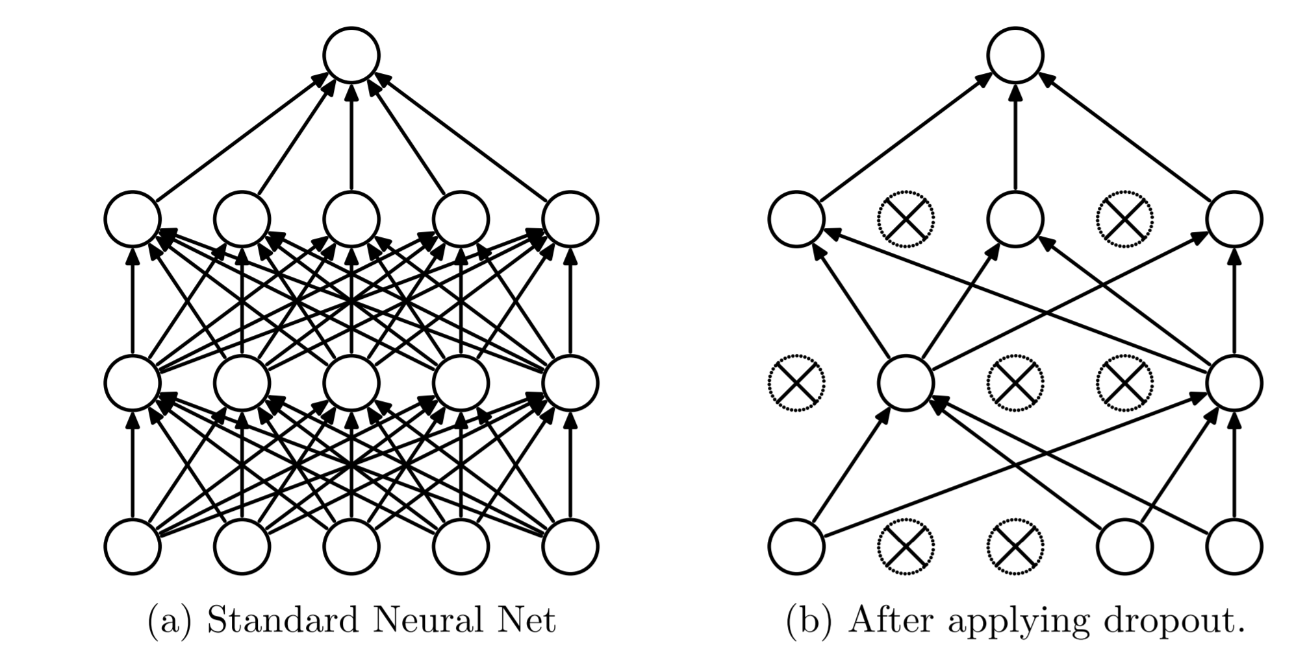
Machine Learning: Dropout
This schematic shows a neural net with two hidden layers. The network on the right is an example of applying dropout to the network on the left
Srivastava. N, Hinton. G et al. 2014, Dropout: A Simple Way to Prevent Neural Networks from Overfitting

Slide 8
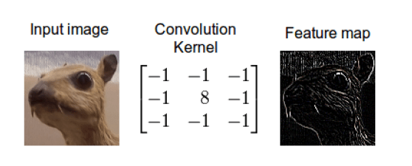
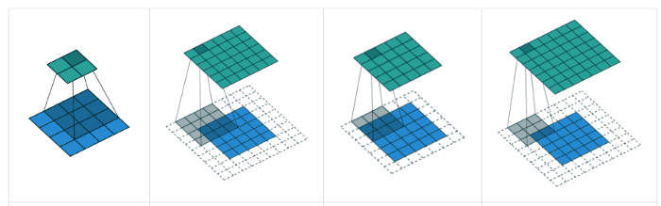
Machine Learning: CNNs
CNNs are often used for image classification.
Neurons are replaced by kernels, or filters.
ReLu activation is then applied
f(x) = max(0,x).
This produces a feature map to be sent to the next layer.
Padding prevents corner pixels being lost.
Stride defines how much the receptive field moves between activations.
https://towardsdatascience.com/the-most-intuitive-and-easiest-guide-for-convolutional-neural-network-3607be47480

Slide 9
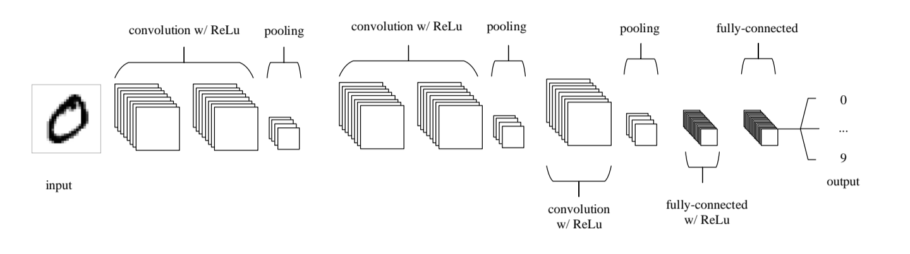
Machine Learning: CNNs
A typical CNN architecture of stacked convolutional and ReLu with pooling layers followed by a fully connected dense layer and activation function.
O'Shea, Keiron; Nash, Ryan, 2015, An Introduction to Convolutional Neural Networks

Slide 10
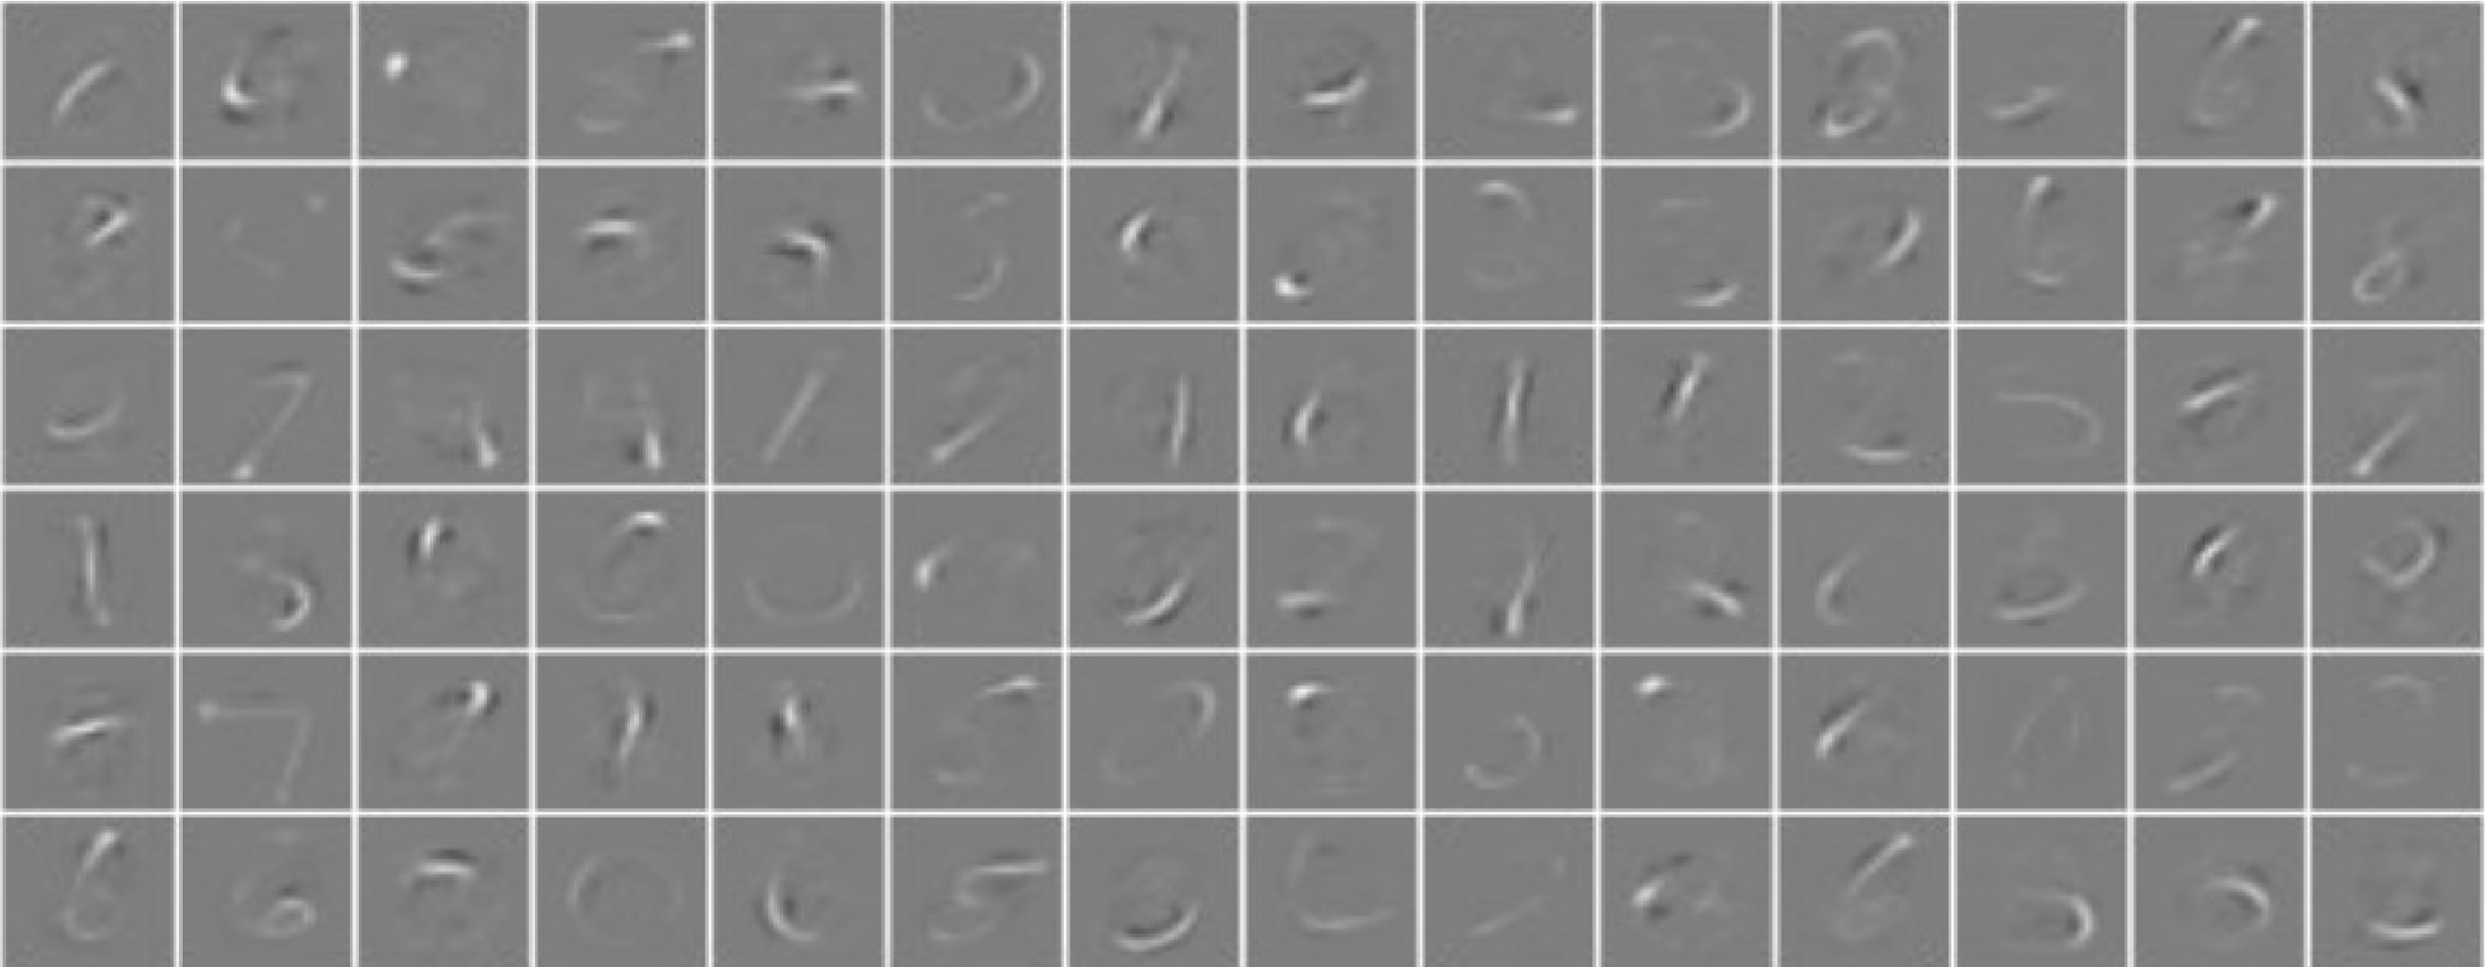
Machine Learning: Feature maps
Feature maps from the first convolutional layer of a CNN after training on the MNIST handwritten digits database
Keiron O’Shea, Ryan Nash, 2015, An Introduction to Convolutional Neural Networks

Slide 11
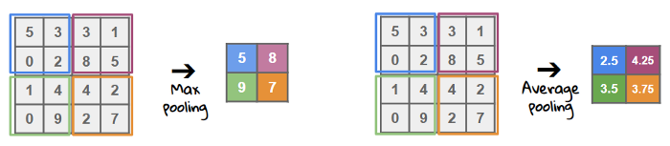
Machine Learning: Pooling
Pooling reduces the amount of data whilst retaining the important features.
Improves computation time.
Mitigates overfitting.
https://towardsdatascience.com/the-most-intuitive-and-easiest-guide-for-convolutional-neural-network-3607be47480

Slide 12
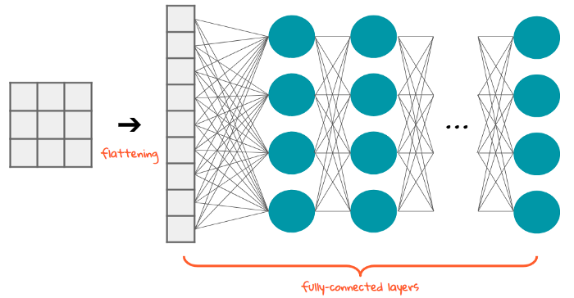
Machine Learning: Image Classification
Flattening layer converts the data into a 1D array called a feature vector.
This vector is then fed into a fully connected (dense) layer.
Finally, into an activation function.
https://towardsdatascience.com/the-most-intuitive-and-easiest-guide-for-convolutional-neural-network-3607be47480

Slide 13
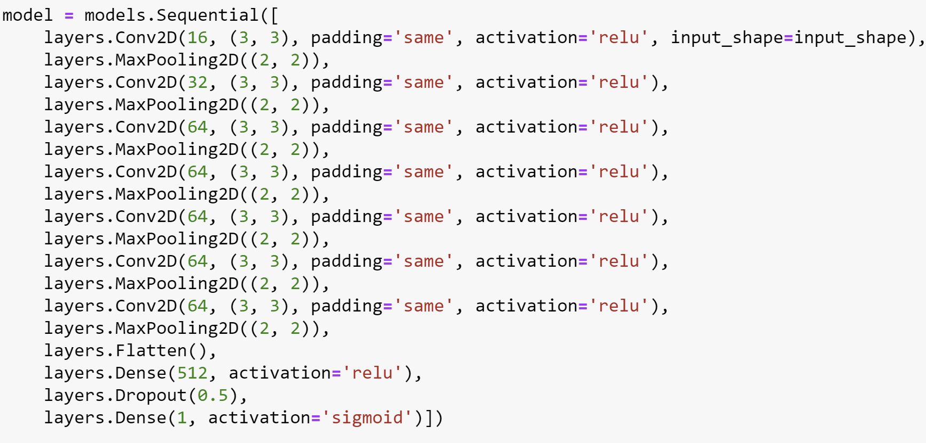
Machine Learning: CNN Model Summary

Slide 14
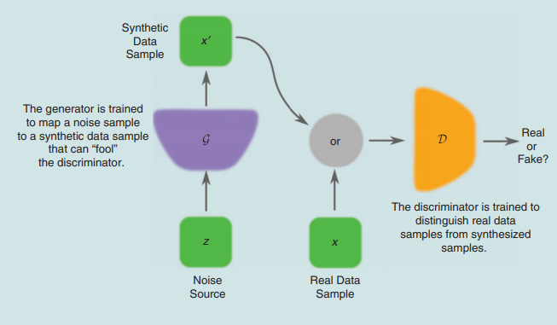
Machine Learning: Model DCGANs
Unsupervised learning.
Allows for a more diverse data augmentation.
Two networks are simultaneously trained.
The generator learns only from the output of the discriminator and aims to fool it.
The discriminator aims to identify fake images from real images.
Creswell, A et al, 2018, Generative Adversarial Networks

Slide 15
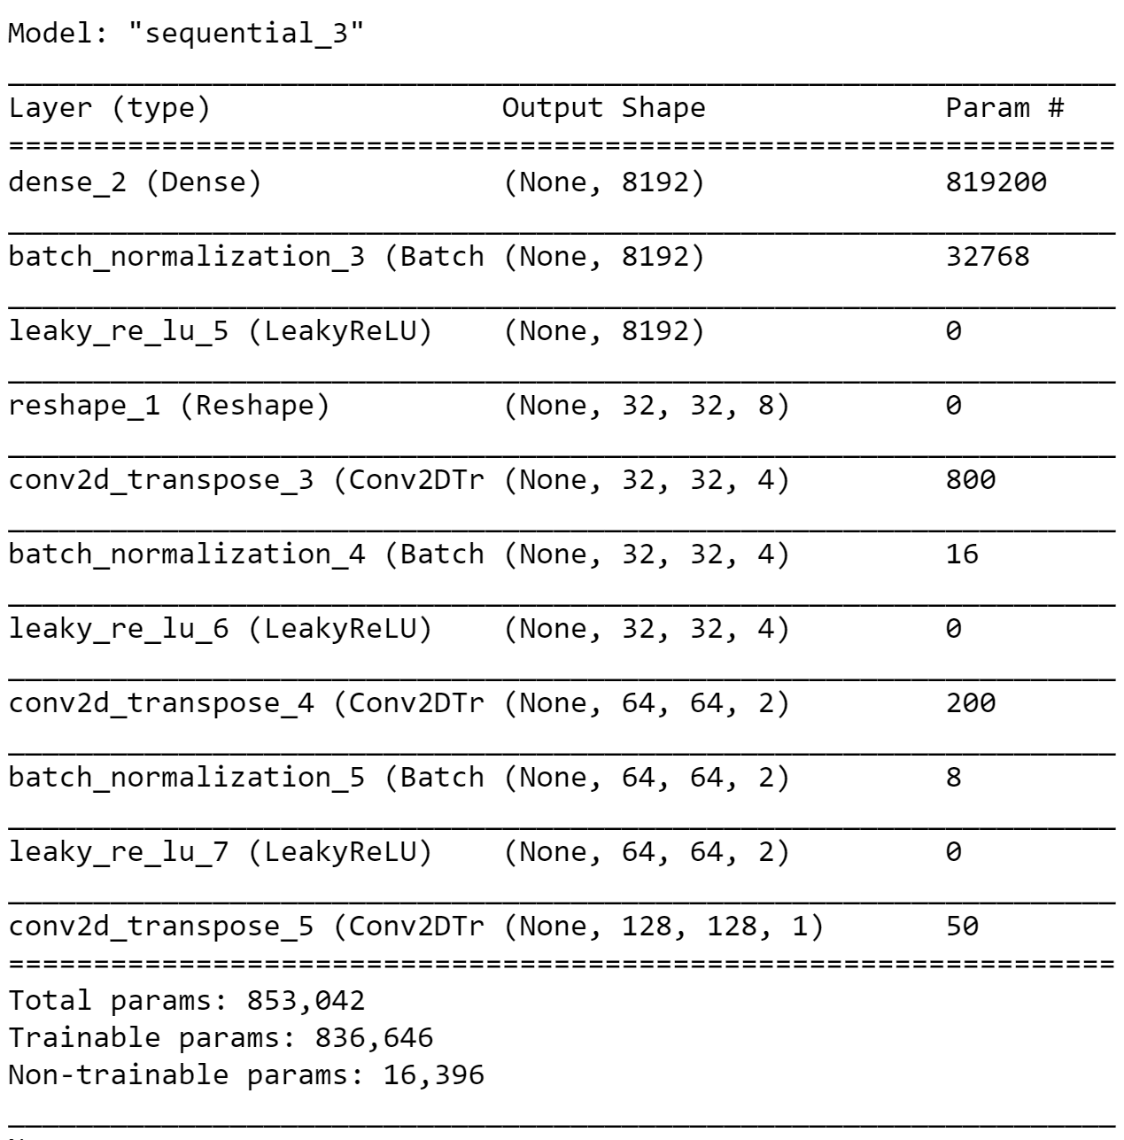
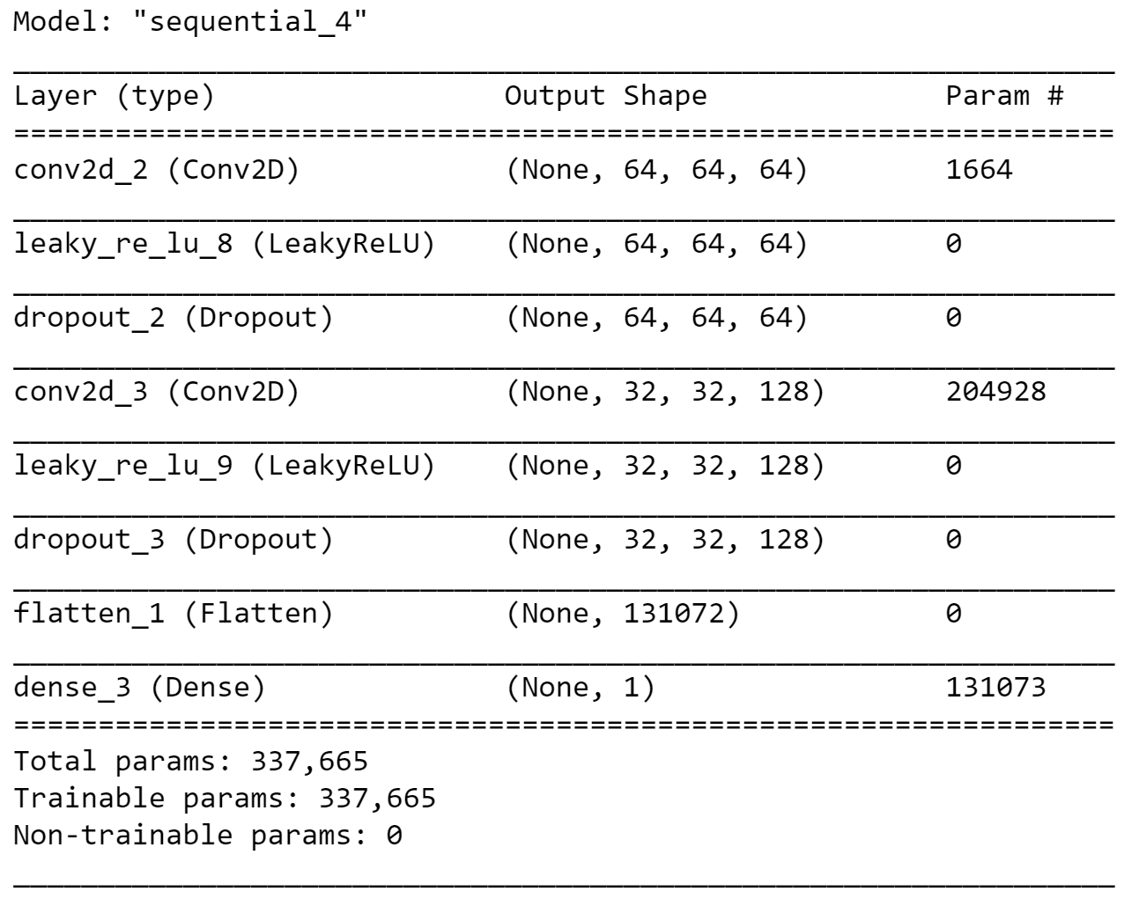
Machine Learning: DCGAN Model Summary
Discriminator model
Generator model

Slide 16
Non-thermal Filaments

Slide 17
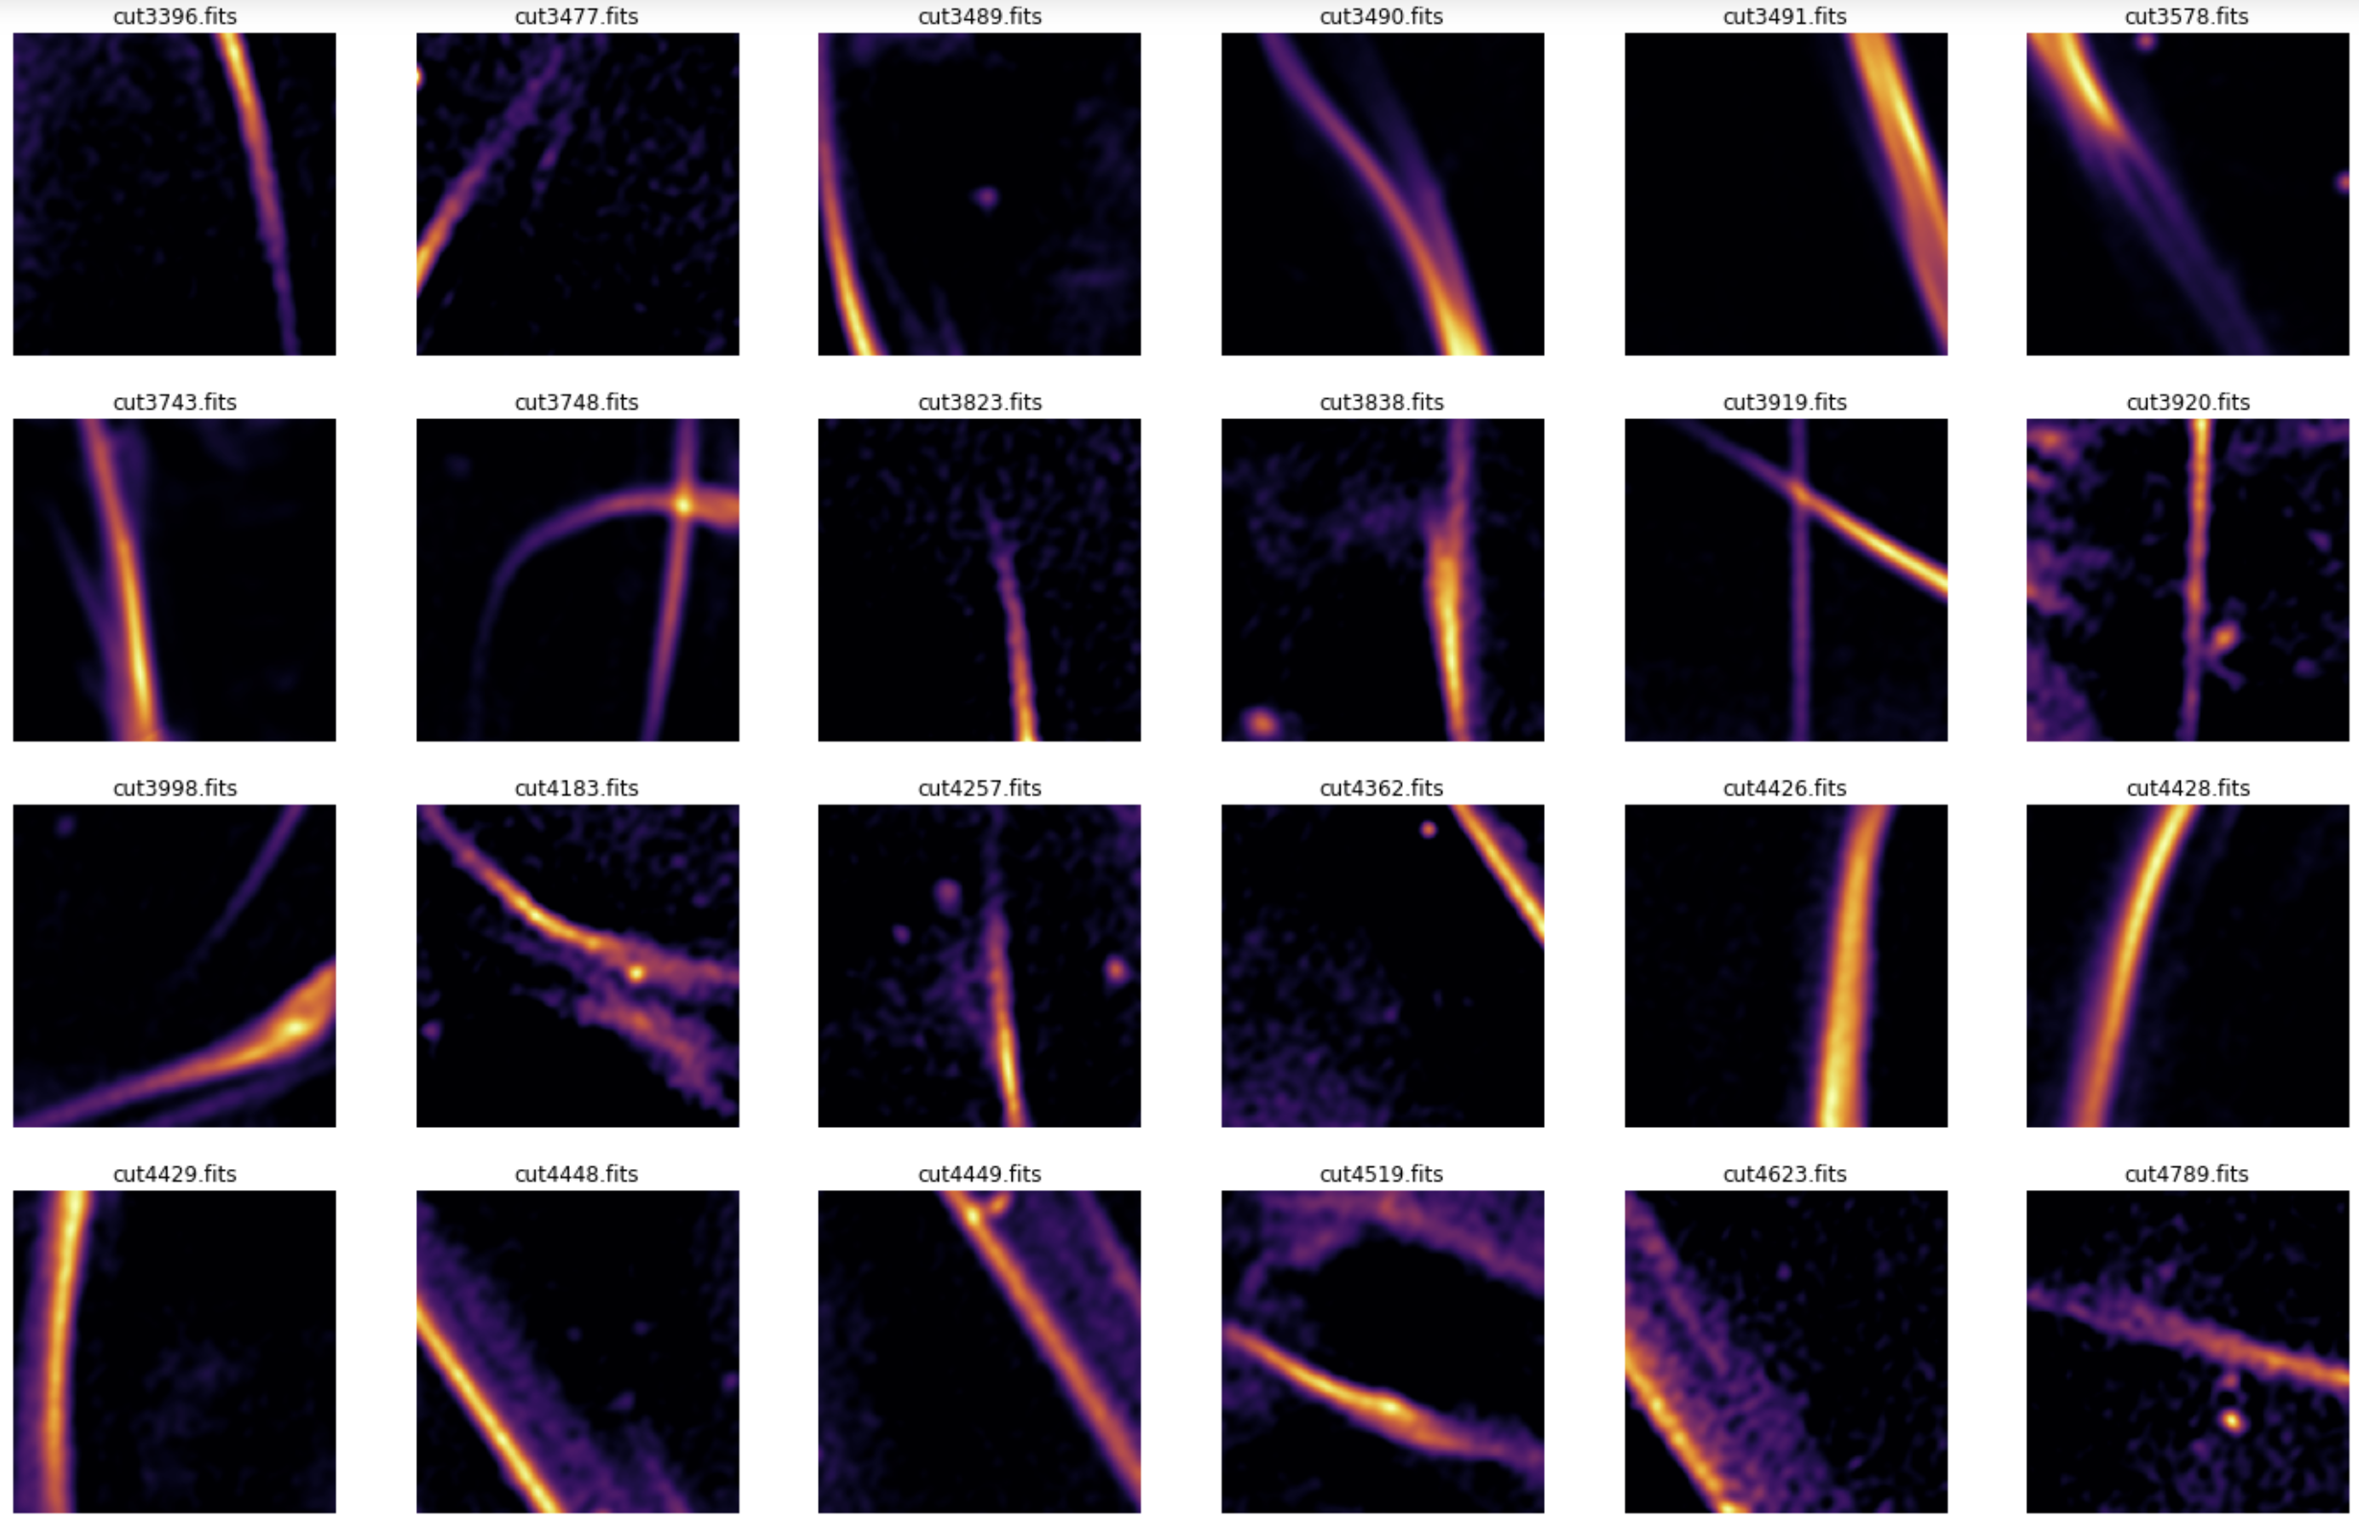
Preliminary Results - Real Filaments

Slide 18
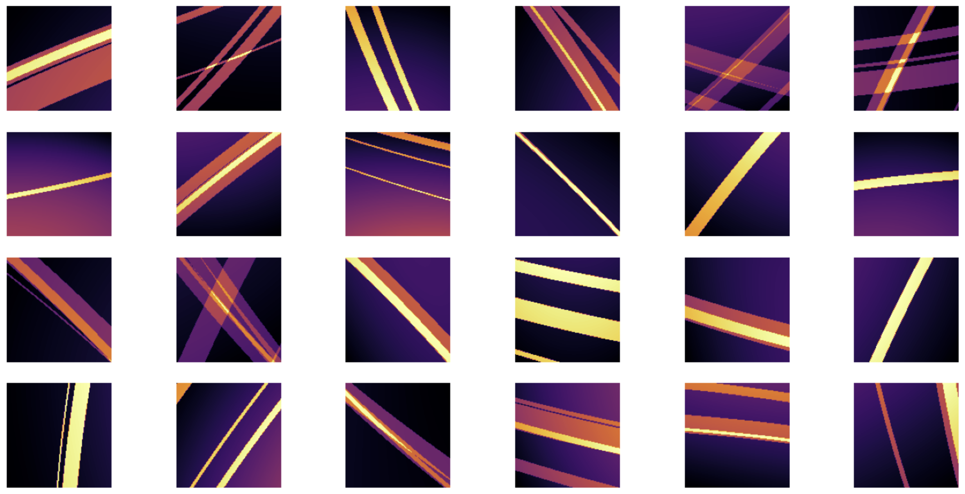
Preliminary Results - Synthetic Filaments

Slide 19
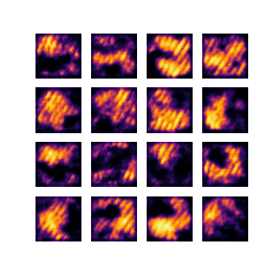
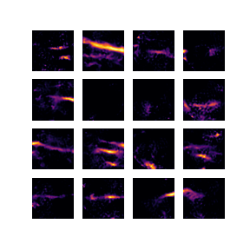
Preliminary Results - Generated Filaments

Slide 20
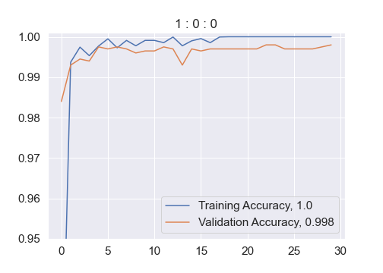
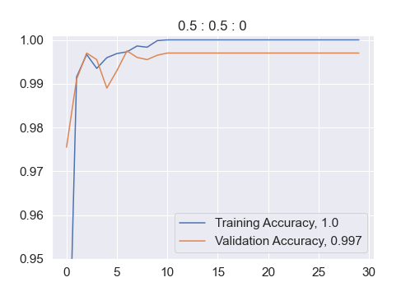
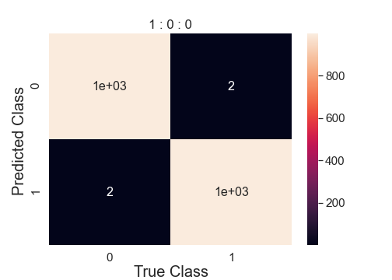
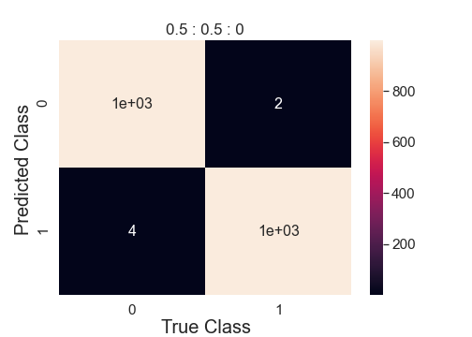
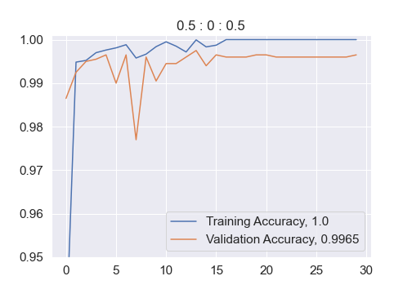
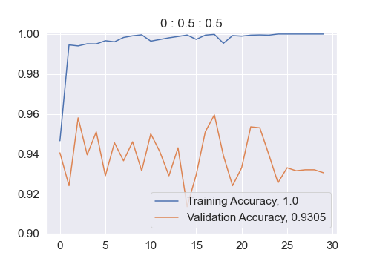

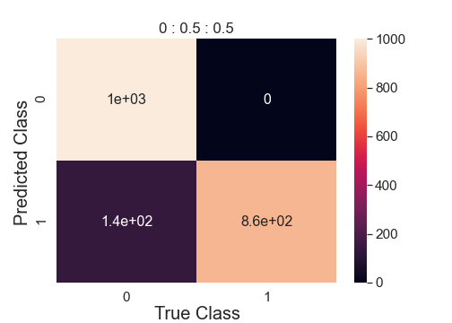
9,000 Non-Filaments with 9,000 Filaments split by Real : GAN : Modelled
Actual label
Actual label
Predicted label
Predicted label
Actual label
Actual label
Predicted label
Predicted label

Slide 21
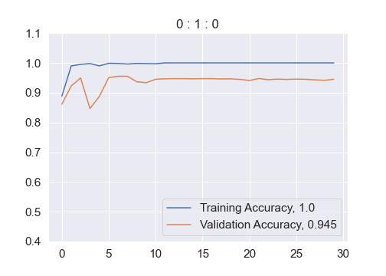
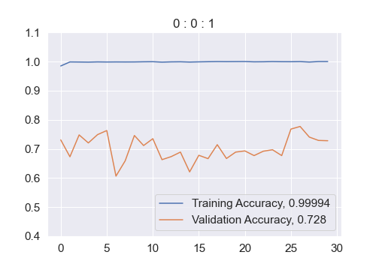
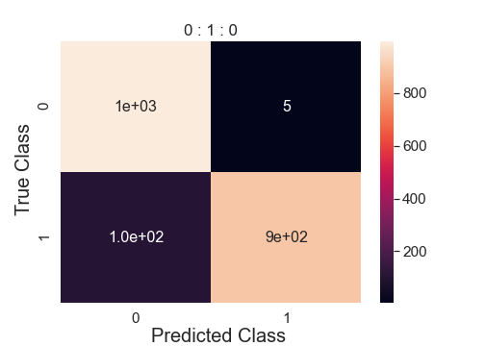
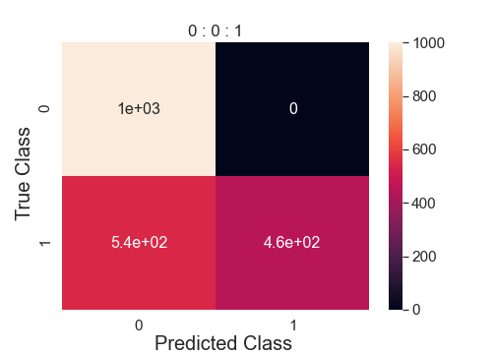
9,000 Non-Filaments with 9,000 Filaments split by Real : GAN : Modelled

